Slide 1


Everybody Sells:
Seizing Opportunities To
Build Your Revenue
(Small Operator Track)
Speakers
Kim J. Garner of BEST Transportation
Kimberly Vissak of Build A Team Consultants

Slide 2


Slide 3
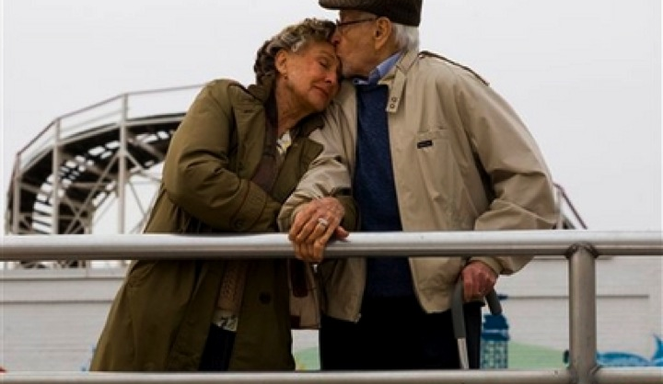




Slide 4


Slide 5
Existing Clients
Think
About
Industries
Seasonality of Work
Price Sensitivity
Demanding (PITA)
Payment

Slide 6
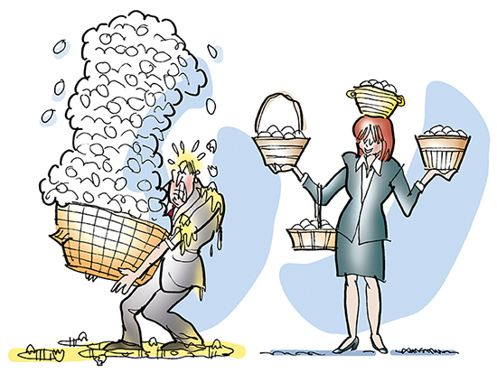

Slide 7


Slide 8

Identify Your Customer
Analyze Revenue

Slide 9
Who Owns Sales?

Slide 10


Slide 11


Slide 12


Slide 13


Slide 14
Everybody Sells
Existing Business
Communication

Slide 15


Slide 16
Everybody Sells: Seizing Opportunities To Build Your Revenue
(Small Operator Track)
Thank You!

Slide 17
Thank you for joining us!
LAST DAY to use those Show Bucks!
Plus: Don’t forget that you can catch brunch on our show floor from 11 a.m. ‘til noon.

